Slide 1
Complex Integration (Line Integral) Exercise:6 (part-3)

Slide 2
Objective:
Evaluating line integrals for the paths which consists of multiple paths (line segments).
Methodologies:
Find the line integrals for each of the path separately and then take their summation for the total line integral consisting of multiple paths.

Slide 3

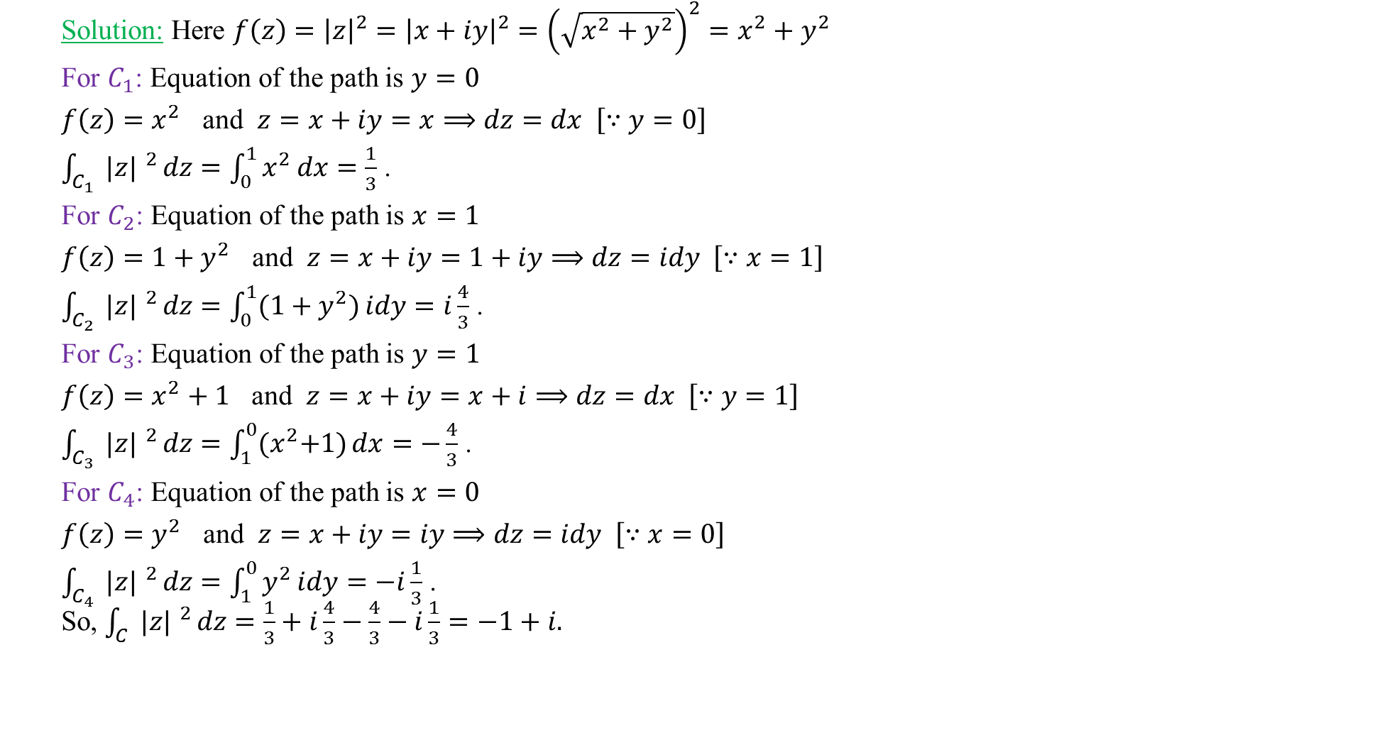

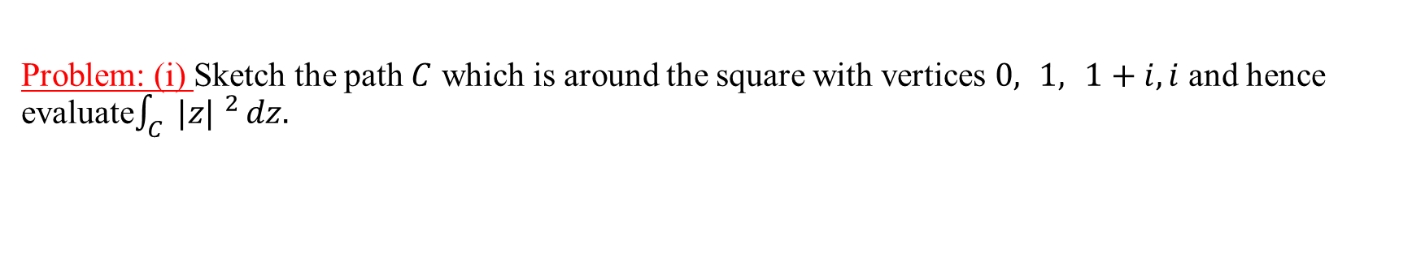






Problem: (i) Sketch the path $C$ which is around the square with vertices $0, 1, 1+i,i$ and hence evaluate$\int_{C}{ |z| ^{2}}dz.$
Solution: Here $f\left(z\right)={\left|z\right|}^{2}={\left|x+iy\right|}^{2}={\left(\sqrt{x^{2}+y^{2}}\right)}^{2}=x^{2}+y^{2}$
For $C_{1}$: Equation of the path is $y=0$
$f\left(z\right)=x^{2}$ and $z=x+iy=x⟹dz=dx \left[∵y=0\right]$
$\int_{C_{1}}{ |z| ^{2}}dz=\int_{0}^{1}{x^{2}}dx=\frac{1}{3}$ .
For $C_{2}$: Equation of the path is $x=1$
$f\left(z\right)={1+y}^{2}$ and $z=x+iy=1+iy⟹dz=idy \left[∵x=1\right]$
$\int_{C_{2}}{ |z| ^{2}}dz=\int_{0}^{1}{{(1+y}^{2})}idy=i\frac{4}{3}$ .
For $C_{3}$: Equation of the path is $y=1$
$f\left(z\right)=x^{2}+1$ and $z=x+iy=x+i⟹dz=dx \left[∵y=1\right]$
$\int_{C_{3}}{ |z| ^{2}}dz=\int_{1}^{0}{{(x}^{2}+1)}dx=−\frac{4}{3}$ .
For $C_{4}$: Equation of the path is $x=0$
$f\left(z\right)=y^{2}$ and $z=x+iy=iy⟹dz=idy \left[∵x=0\right]$
$\int_{C_{4}}{ |z| ^{2}}dz=\int_{1}^{0}{y^{2}}idy=−i\frac{1}{3}$ .
So, $\int_{C}{ |z| ^{2}}dz=\frac{1}{3}+i\frac{4}{3}−\frac{4}{3}−i\frac{1}{3}=−1+i.$
Im {z}
$$(0,1)$$
$$C_{3}$$
$$(1,1)$$
$$C_{4}$$
$$C_{2}$$
$$C_{1}$$
O
$$(0,0)$$
$$(1,0)$$
Re {z}

Slide 4

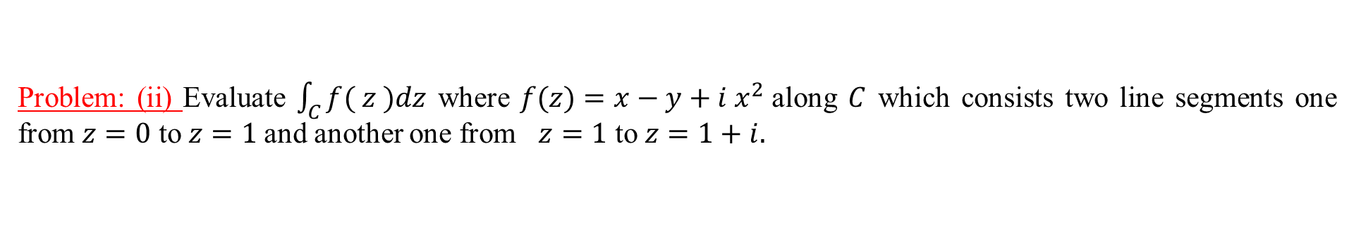
Problem: (ii) Evaluate $\int_{C}{f( z )dz}$ where $f(z)=x−y+i x^{2}$along $C$ which consists two line segments one from $z=0$ to $z=1$and another one from $z=1$ to $z=1+i.$
Solution: Here $f\left(z\right)=x−y+i x^{2}$
For $C_{1}$: Equation of the path is $y=0$
$f\left(z\right)={x+i x}^{2}$ and $z=x+iy=x⟹dz=dx \left[∵y=0\right]$
$\int_{C_{1}}{ f\left(z\right)}dz=\int_{0}^{1}{(x+ix^{2})}dx=\frac{1}{2}+i\frac{1}{3}$ .
For $C_{2}$: Equation of the path is $x=1$
$f\left(z\right)=(1−y+i)$and $z=x+iy=1+iy⟹dz=idy \left[∵x=1\right]$
$\int_{C_{2}}{ f(z)}dz=\int_{0}^{1}{1−y+i)}idy=\frac{1}{2}i−1$.
So, $\int_{C}{ f(z)}dz=\frac{1}{2}+i\frac{1}{3}+\frac{1}{2}i−1=−\frac{1}{2}+i\frac{5}{6}.$
Im {z}
$$(1,1)$$
$$C_{2}$$
$$C_{1}$$
O
$$(0,0)$$
$$(1,0)$$
Re {z}

Slide 5



Problem: (iii) Evaluate$\int_{C}{ \left(\frac{1}{z−i}− \frac{2}{{\left(z−i\right)}^{2 }}\right)dz}$along $C$ which is the circle $\left|z−i\right|=4$ , clockwise.
Solution: Here equation of the path is $\left|z−i\right|=4⟹z−i=4e^{iθ}$
$∴f\left(z\right)=\left(\frac{1}{z−i}− \frac{2}{{\left(z−i\right)}^{2 }}\right)=\left(\frac{1}{4e^{iθ}}−\frac{2}{16e^{i2θ}}\right)$
and $z=re^{iθ}=4e^{iθ}⟹dz=4ie^{iθ}dθ \left[∵r=4\right]$
$\int_{C}{ f\left(z\right)}dz=\int_{2π}^{0}{\left(\frac{1}{4e^{iθ}}−\frac{2}{16e^{i2θ}}\right)}4ie^{iθ}dθ$
$=i\int_{2π}^{0}{\left(1−\frac{1}{2e^{iθ}}\right)dθ}=i\int_{2π}^{0}{\left(1−\frac{1}{2}e^{−iθ}\right)dθ}$
$=i{\left[θ−\frac{1}{2}\frac{e^{−iθ}}{\left(−i\right)}\right]}_{2π}^{0}$ $=i\left[\frac{1}{2i}−2π−\frac{e^{−i2π}}{2i}\right]=−2πi \left[∵e^{−i2π}=1\right].$
Im {z}
$$(0,1)$$
$$4$$
O
Re{z}

Slide 6
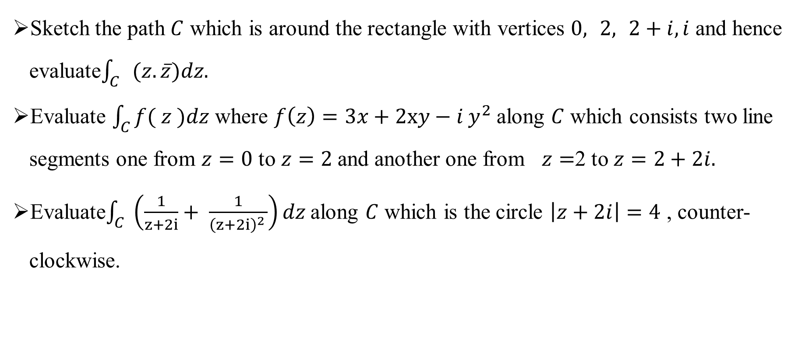
Exercises:
Sketch the path $C$ which is around the rectangle with vertices $0, 2, 2+i,i$ and hence evaluate$\int_{C}{ }(z.\overline{z})dz.$
Evaluate $\int_{C}{f( z )dz}$ where $f\left(z\right)=3x+2xy−i y^{2}$along $C$ which consists two line segments one from $z=0$ to $z=2$and another one from $z=$2 to $z=2+2i.$
Evaluate$\int_{C}{ \left(\frac{1}{z+2i}+ \frac{1}{{\left(z+2i\right)}^{2 }}\right)dz}$along $C$ which is the circle $\left|z+2i\right|=4$ , counter-clockwise.

Slide 7
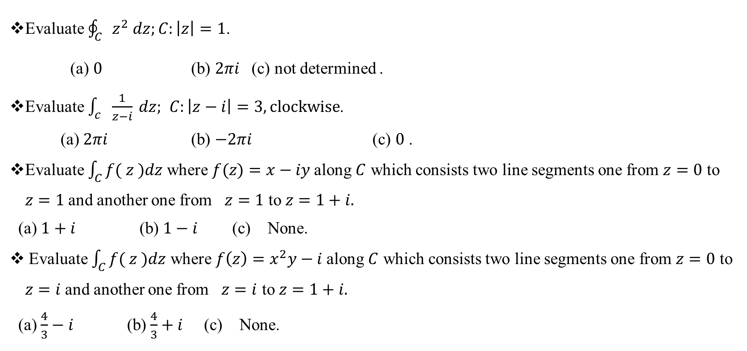
Sample MCQ
Evaluate $\oint_{C}{z^{2} dz;C:\left|z\right|=1}$.
(a) $0$ (b) $2πi$ (c) not determined .
Evaluate $\int_{c}{\frac{1}{z−i} dz;}$ $C:\left|z−i\right|=3, clockwise$.
(a) $2πi$ (b) $−2πi$ (c) $0$ .
Evaluate $\int_{C}{f( z )dz}$ where $f(z)=x−iy$along $C$ which consists two line segments one from $z=0$ to $z=1$and another one from $z=1$ to $z=1+i.$
(a) $1+i$ (b) $1−i$ (c) None.
Evaluate $\int_{C}{f( z )dz}$ where $f\left(z\right)=x^{2}y−i$along $C$ which consists two line segments one from $z=0$ to $z=i$and another one from $z=i$ to $z=1+i.$
(a) $\frac{4}{3}−i$ (b) $\frac{4}{3}+i$ (c) None.

